Slide 1
Indoor Localization Using Computer Images
Yarkın Alpmen Akyosun &
Kağan Kağanoğlu

Slide 2
Outline
Background
Translation and Orienation (quaternion)
Loss function (training)
Methodology - Swin
Training
Results
Comparison
Future Work

Slide 3
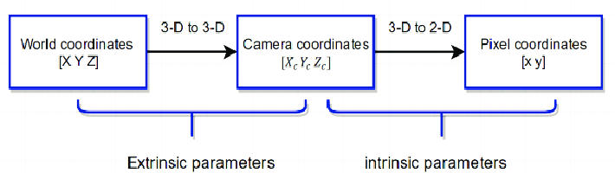
Background
Camera pose: Translation & Orientation
Learning world coordinates of camera from projected pixel images

Slide 4
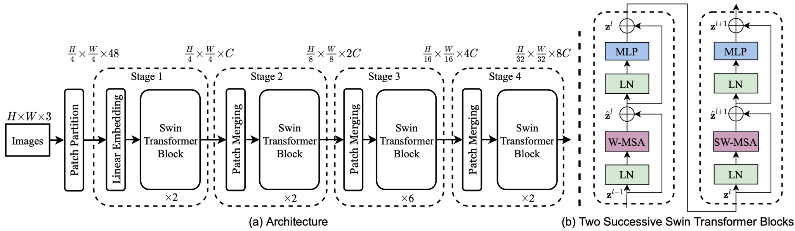
Swin’s Architechture
Patch Embedding
Hierarchical Processing

Slide 5
Preprocessing & Model Customization
Image Size: 256x256
Change model head
Split the data to train-test

Slide 6
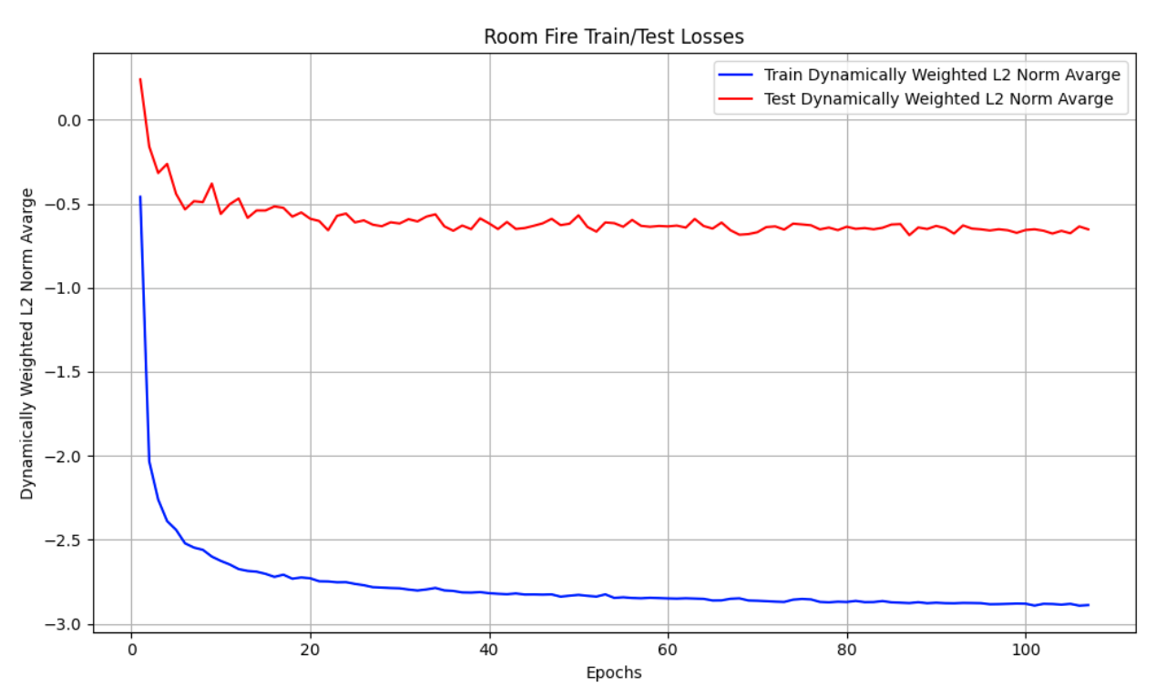
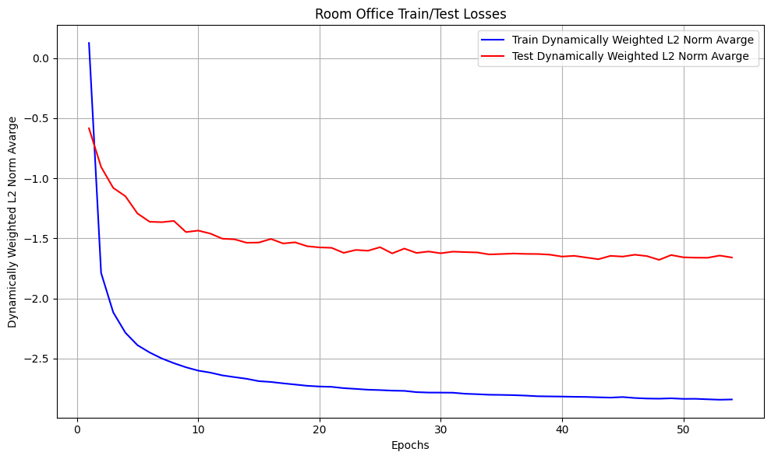
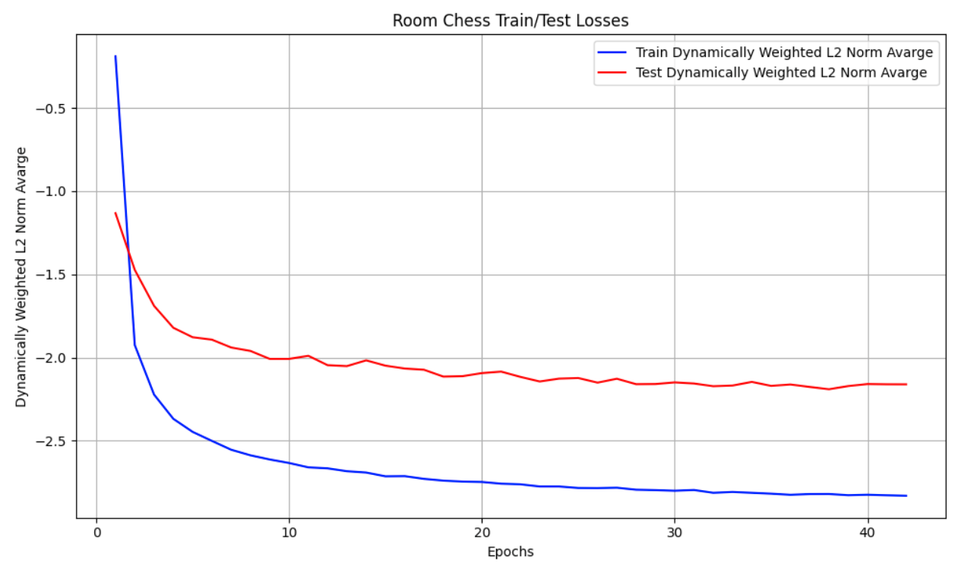
Training
Batch Size = 6
Learning Rate = 1e-5
CameraPoseLoss from the paper “Geometric loss functions for camera pose regression with deep learning”

Slide 7
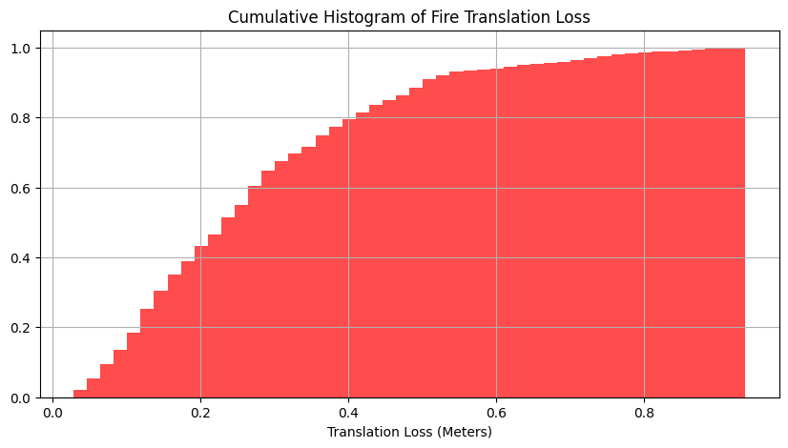
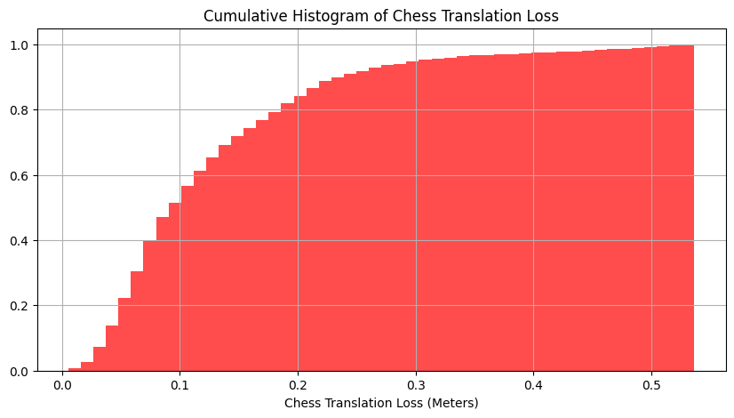
Cumulative Loss Histograms (Translation)

Slide 8
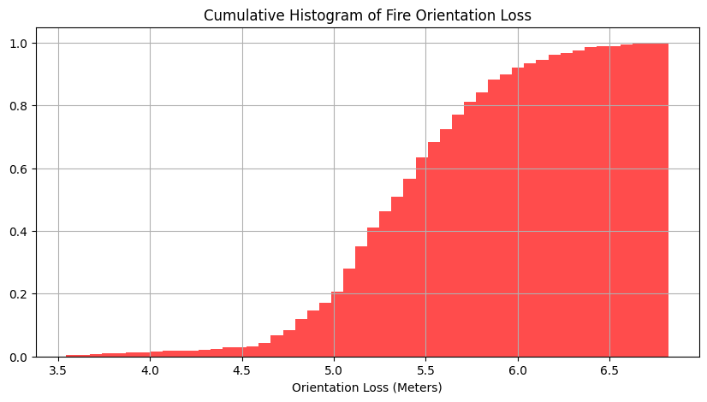
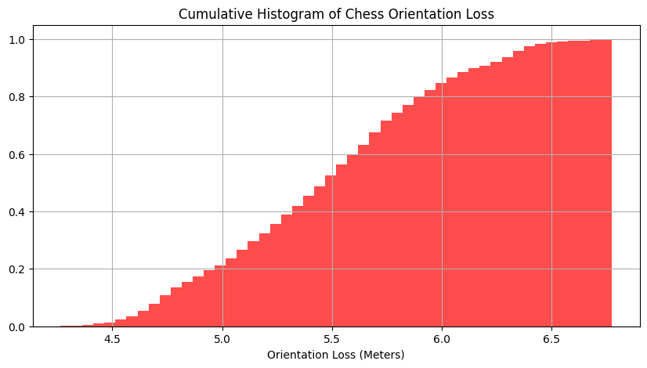
Cumulative Loss Histograms (Orientation)

Slide 9
Results
Comparison with Alex Kendall 2015 paper
Scene | Train | Test | Extent (m) | Nearest Neighbour | PoseNet | Dense PoseNet | Ours
Chess | 4000 | 2000 | 3 x 2 x 1 | 0.41m, 11.2° | 0.32m, 8.12° | 0.32m, 6.60° | 0.13m, 4.07°
Fire | 2000 | 2000 | 2.5 x 1 x 1 | 0.54m, 15.5° | 0.47m, 14.4° | 0.47m, 14.0° | 0.28m, 11.85°
Office | 6000 | 4000 | 2.5 x 2 x 1.5 | 0.49m, 12.0° | 0.48m, 7.68° | 0.48m, 7.24° | 0.21m, 6.50°

Slide 10
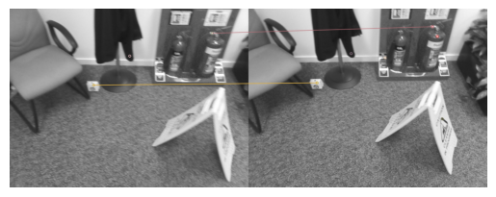
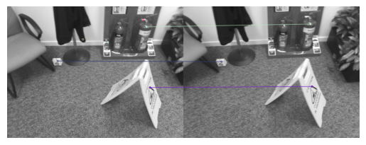
Improving over Swin’s Approximation
Point Cloud Formation
Keypoint set creation, sift with sliding window over images
Back projection of set points, yielding “rays”
Optimal point position minimising L2 for every point optimise w

Slide 11
Improving over Swins approximation
Exact position from approximation
Accurate position from approximation
Swins position and orientation approximation yield a FOV
Midas depth estimation with FOV yield points to pick
Solve linear system for cameras position

